Slide 1
T5 Transformer An Advanced Summarization Tool
Team 8
Jiatong Li, Mark Chen, Xiaowen Tang, Weizhong Yao
Notes:
**Edit it cuz its confused
Clearify newspaper
Using t5 newspaper to summarize**
Using the Python packages T5-Transformer and NewsPaper to Summarize Large amounts of text information quickly.
Slice 2: bring the email
Slice 3: PYTHON Huge Time saving and energy saving
makes it easy to find revelent information faster
Slice 4: Main point in slice is more about T5, for example
reorginize it to other place.
Easy to use put in the end.
Too much text
Not limited to text, also audio, and hard copy
we do not have the benefit here, reinforce the benefit, now gorege got the
Talk just use transformance
text artivcle, T5 is able to handle difference source, how much time saved, how accurate, combines well with other
saving time
energy time

Slide 2
How Much Information Can You Handle?
1.9 Billion active websites
2.5 Hours per day searching for information needed
Notes:
There’re about 1.9 billion websites online, and 2.7 million emails being sent per second. That’s a lot of information. But how much time we are spending on handling this. According to the latest research, on average, we spend 2.5 hours per day on searching for information needed online, and 25% of the workday on email-related tasks. Then we may ask if there’s a way to save our time and effort on this by advanced tools like Python.

Slide 3

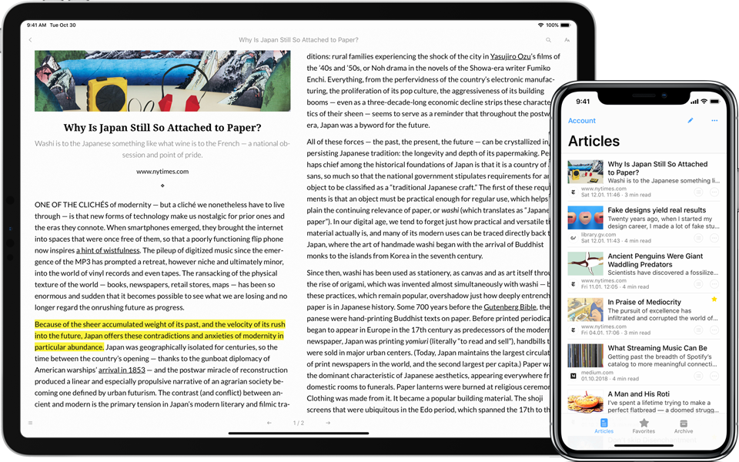

T5 Summarizes Various Information for Human
Scanned Hard Copy
T5 Transformer
Original Text
Summary
Website Articles
Audio Recording
Notes:
We are introducing a solution to summarize information faster and easier by a Python package, called T5 Transformer. It accepts not only the articles, but also the scanned hard copies and even audio recordings from your Zoom meetings as the data source. We can scrap the texts by common tools like Newspaper3k for articles, and voice recognition for meeting recordings, to prepare the original text for T5 to analyze. Then we apply T5 Transformer to summarize the major points from the text.

Slide 4

T5 Transformer Serves Multi-functionally
Summarization:
“state authorities dispatched emergency crews Tuesday to survey the damage after an onslaught of severe weather ...”
Translation: English to German: “ That is good.”
Linguistic Acceptability:
“The course is jumping well.”
Sentence Similarity: “The rhino grazed on the grass. ”; “A rhino is grazing in a field.”
T5 Transformer
“Das ist gut.”
“Not acceptable”
“3.8”
(Highly Similar)
“Six people hospitalized after a storm in attala county.”
When was Franklin D. Roosevelt born?
1882
Notes:
T5 transformer contains multiple useful functions and could performs extremely well in each task. T5 transformer allows us to use the same model, loss function, and hyperparameters across our diverse set of tasks including translation, linguistic acceptability, sentence similarity (yellow), and document summarization (blue). We can see from the blue box that T5 summarize a long text into a single sentence for us to easily comprehend in just 5 second. And there are lots of extensions on summarizations for example, reading comprehension, if we run a historic script on T5 and we want to know when was franklin Roosevelt born? Python would gather information from the text and directly tell us that he was born on 1882.

Slide 5
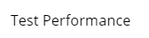
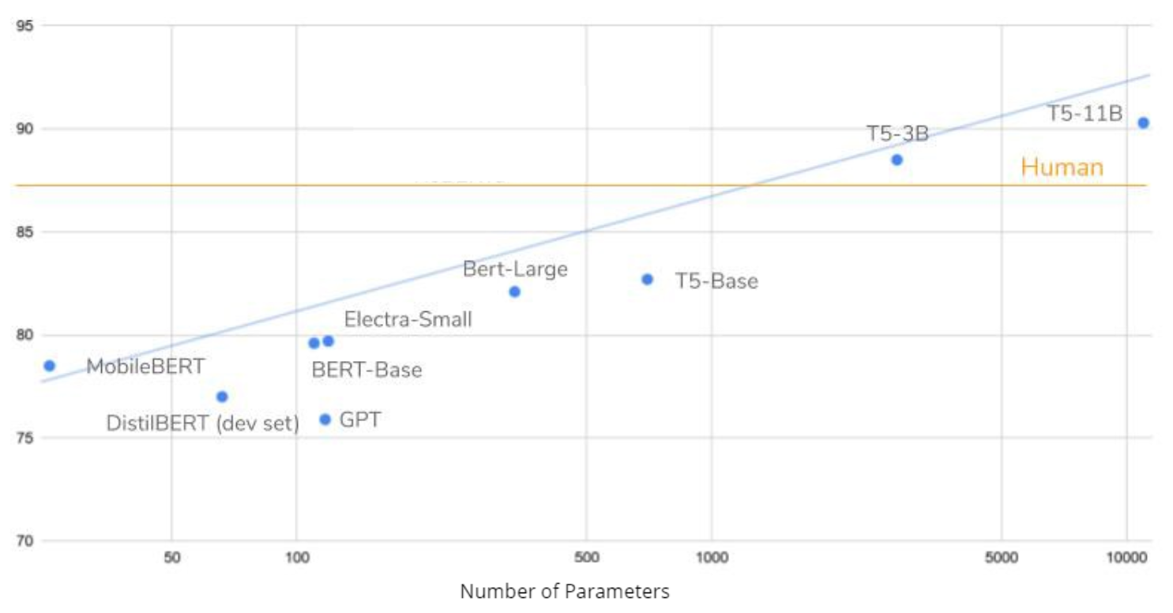

T5 Transformer Is More Accurate and More Efficient
Deep Learning Models VS Traditional Algorithm
T5 Transformer VS Other Deep Learning Models
Traditional Algorithm: Identify the significant sentences from the document, do not generate new sentences
T5 can even outperform human
Trained on larger dataset
Have both Encoder and Decoder Blocks
T5 is more computationally efficient with better performance
Deep Learning Models: “Learn” the content and generate new sentences that convey the core information.
Notes:
There are various techniques that can do the summarization, why we choose T5 here?
T5 is a deep learning model, so how deep learning model perform better than the traditional algorithm?
Traditional NLP algorithm such as textrank generate the summary by identifying significant sentences.
However, deep learning model was trained to “learn” the content and generate new sentences that convey the core information.
Next, among all the deep learning model, why T5 stand out?
Most of the deep learning model have either encoder or decoder blocks, T5 have both, and T5 was also was trained on larger dataset which gaurantees a better performance. Let’s look at the chart on the right, There are several versions of T5 model based on number of parameters, T5 with 3 billion and 11 billion parameters can even outperform human.
Summarized text: said this week it would sell its loss-making flying taxi unit to Joby Aviation, an electric passenger aircraft developer. Uber said this week it would sell its loss-making flying taxi unit to Joby Aviation. Hyundai Motor says it has agreed to buy an 80% stake in robot maker Boston Dynamics from SoftBank Group Corp. the deal values the robot firm at $1.1 billion, suggesting Hyundai offered $880 million for the 80% stake. Hyundai can leverage robot technology to expand automation at its unionized car factories, as well as design autonomous vehicles
Unlike BERT, which had only encoder blocks, and GPT-2, which had only decoder blocks, T5 uses both.
GPT-2 being trained on 40 GB of text data was already impressive, but T5 was trained on a 7 TB dataset. Even though it was trained for a very, very large number of iterations, it could not go through all the text. computationally efficient
#Using deep learning model can achieve more sophisticated abilities that are crucial to high-quality summarization.
First, extractive summarization systems form summaries by copying and rearranging passages from the original text. Second, abstractive summarization systems generate new phrases, rephrasing or using words that were not in the original text. Due to the difficulty of abstractive summarization, the great majority of past work has been extractive.
On the other hand, sophisticated abilities that are crucial to high-quality summarization, such as paraphrasing, generalization, or the incorporation of real-world knowledge, are possible only in an abstractive framework. Even though abstractive summarization is a more challenging task, there has been a number of advances so far, thanks to recent developments in the deep learning area.
So how we leverage these two packages to generate summarization?
It is simple, first, use newpaper to scrape information needed, such as author, publish time and content that are of our interest. Also, there are other sources of articles depend on the different business application. Such as scanning a report from a hard copy and recognize audio from a speech.
Having the document, Next we could do the summarization.

Slide 6
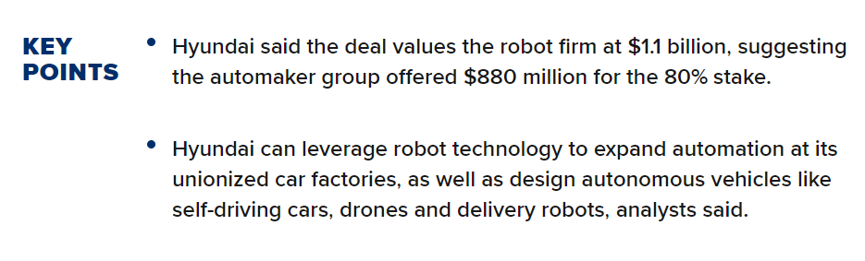
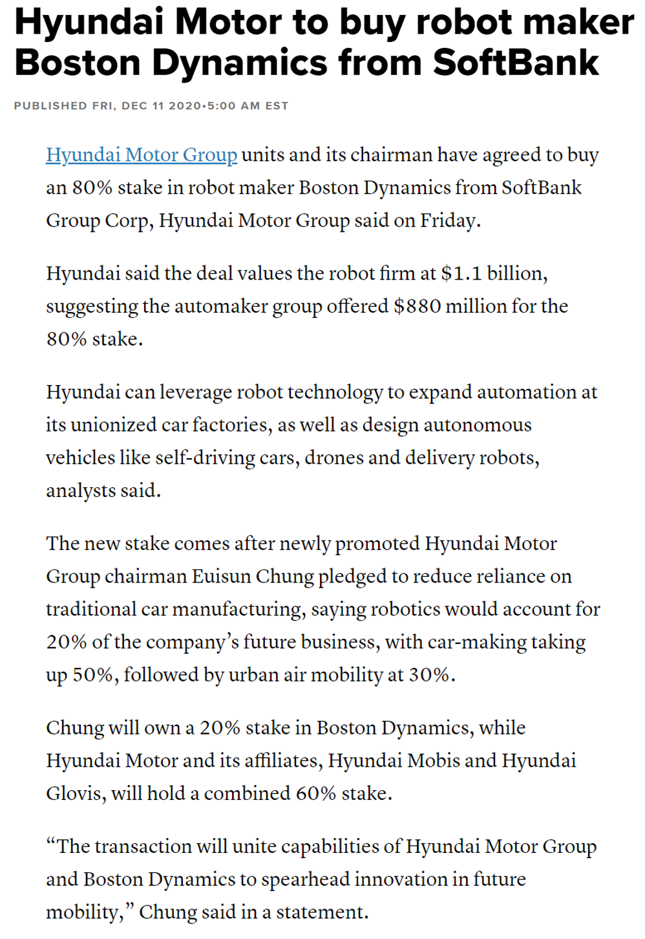
T5 Transformer Is More Accurate and More Efficient
More information
More precise
More Concise
More Information
More Information
More Precise
Traditional Algorithm:
Hyundai Motor Group units and its chairman have agreed to buy an 80% stake in robot maker Boston Dynamics from SoftBank Group Corp, Hyundai Motor Group said on Friday.
"The transaction will unite capabilities of Hyundai Motor Group and Boston Dynamics to spearhead innovation in future mobility," Chung said in a statement
More Concise
More Concise
T5 Transformer:
Hyundai Motor says it has agreed to buy an 80% stake in robot maker Boston Dynamics from SoftBank Group Corp. The deal values the robot firm at $1.1 billion, suggesting Hyundai offered $880 million for the 80% stake.
Hyundai can leverage robot technology to expand automation at its unionized car factories, as well as design autonomous vehicles
Notes:
This is a part of the news from CNBC that talks about Hyundai buy Boston Dynamics. I passed the main body of the article to the traditional textrank model and T5. And then compare the results with the key points summarized by the publisher afterwoards.
Let’s see what traditional algorithm got, it selected two important sentences from article. And one of which covers part of the key information, which is the percentage of state it’s gonna buy.
Now let’s see what T5 gave us, in addition to the 80% of the stake that the traditional one covers, it also extract the firm value of of 1.1 billion and offer amount of 880 millions from a separate part of the acritical to form a new sentence, besides, it also capture another key point that how Hyundai is gonna leverage the robot technology.
From the result, we can see that the summary that T-5 generated more precisely captured more information without sacrifice the conciseness
Summarized text:
's robotics business. It also marks the fading of SoftBank's robotics ambitions as CEO Masayoshi Son focuses on investing. It also leaves SoftBank's own rump robotics business, which includes humanoid robot Pepper, looking increasingly isolated. Hyundai Motor said the deal values the robot firm at $1.1 billion, suggesting the automaker group offered $880 million for the 80% stake. Hyundai can leverage robot technology to expand automation at its unionized car factories, as well as design

Slide 7
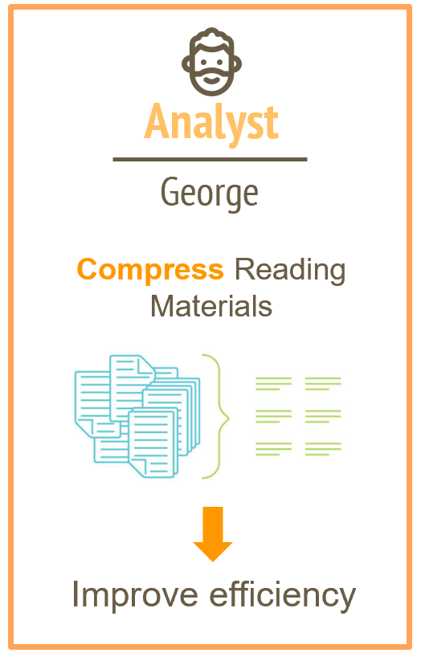
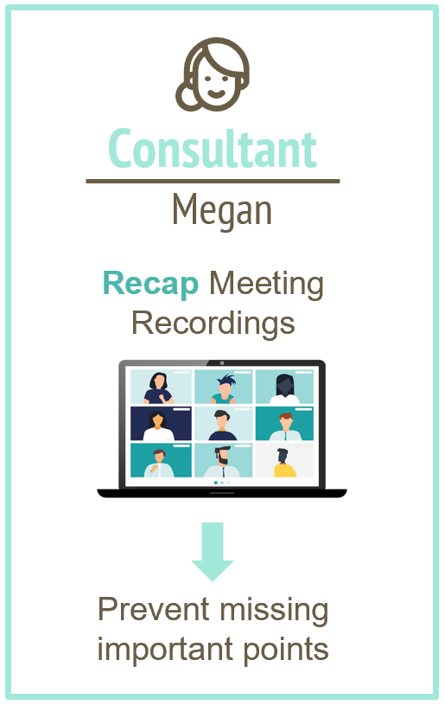


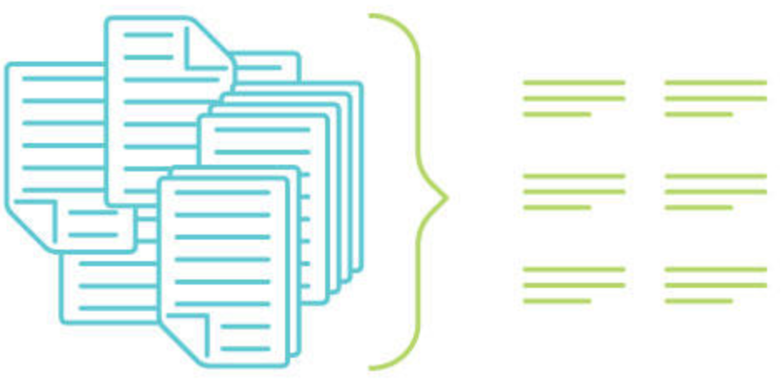
Real-life Scenario Application
Analyst
Consultant
Product Manager
George
Megan
Mary
Summarize User
Feedbacks
Recap Meeting Recordings
Compress Reading Materials
Stay objective and accurate
Prevent missing important points
Improve efficiency
Notes:
Now, Let's put our project into real life setting.
Our first potential user is George, an analyst in a market research company. He told us that 70 percent of his time was spent on reading through reports and news in the industry. Our solution is gonna change his life. If George implements T5 into his work, it’ll improve his efficiency significantly, which means that he could save some time to work on other tasks.
Move on to the next example, Megan, a consultant who has countless meetings with clients. And it’s impossible to remember every feedback from her clients. Now, combining with other python packages, t5 can help Megan transform meeting videos into texts and summarize all important meeting notes smoothly, it’ll not only save her a bunch of time, but also prevent her from missing any important point.
Finally, Mary is a product manager from a technology company. One important part of her job is to gather, analyze, and present responses from active users to other teams. As the amount of work builds up and up, it’s only a matter of time that he gets sloppy and brings biases into these data. In order to show those feedbacks as objective as possible, it’ll be helpful to use a solution like T5 to offer a direct and “honest” summary of those responses at the same time.
In short, T-5 transformer is highly applicable in various fields and will provide great assistance to your business.

